Slide 1
Data Mining:
Concepts and Techniques
Classification
— Chapter 8 —

Slide 2
Chapter 8. Classification: Basic Concepts
Classification: Basic Concepts
Decision Tree Induction
Bayes Classification Methods
Rule-Based Classification
Model Evaluation and Selection
Techniques to Improve Classification Accuracy: Ensemble Methods
Summary

Slide 3
Supervised vs. Unsupervised Learning
Supervised learning (classification)
  Supervision: The training data (observations, measurements, etc.) are accompanied by labels indicating the class of the observations
  New data is classified based on the training set
Unsupervised learning (clustering)
  The class labels of training data is unknown
  Given a set of measurements, observations, etc. with the aim of establishing the existence of classes or clusters in the data

Slide 4
Prediction Problems: Classification vs. Numeric Prediction
Classification
  predicts categorical class labels (discrete or nominal)
  classifies data (constructs a model) based on the training set and the values (class labels) in a classifying attribute and uses it in classifying new data
Numeric Prediction
  models continuous-valued functions, i.e., predicts unknown or missing values
Typical applications
  Credit/loan approval:
  Medical diagnosis: if a tumor is cancerous or benign
  Fraud detection: if a transaction is fraudulent
  Web page categorization: which category it is

Slide 5
Classification—A Two-Step Process
STEP I
Model construction: describing a set of predetermined classes
  Each tuple/sample is assumed to belong to a predefined class, as determined by the class label attribute
  The set of tuples used for model construction is training set
  The model is represented as classification rules, decision trees, or mathematical formulae

Slide 6


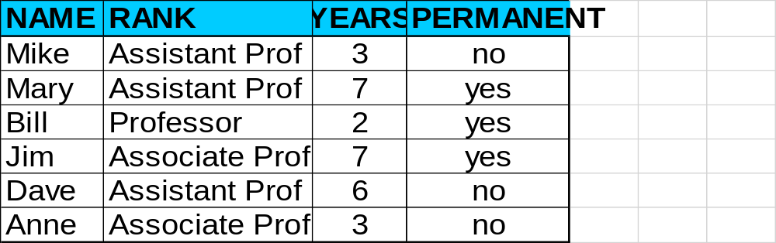
Process (1): Model Construction
Classification
Algorithms
Training
Data
Classifier
(Model)
IF rank = ‘professor’
OR years > 6
THEN permanent = ‘yes’

Slide 7
Classification—A Two-Step Process
STEP I
Model construction: describing a set of predetermined classes
  Each tuple/sample is assumed to belong to a predefined class, as determined by the class label attribute
  The set of tuples used for model construction is training set
  The model is represented as classification rules, decision trees, or mathematical formulae

Slide 8
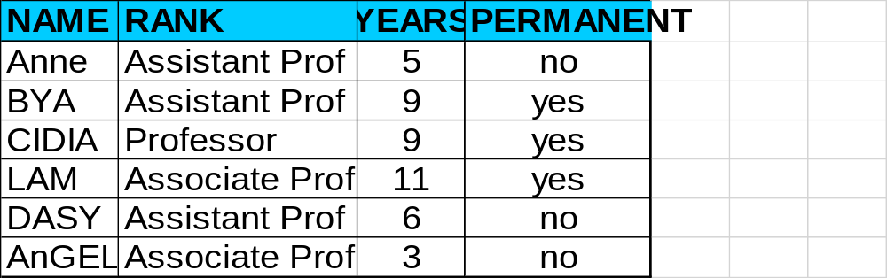
Process (1): Model TESTING
Classification
Algorithms
TESTING
Data
Classifier
(Model)
IF rank = ‘professor’
OR years > 6
THEN permanent = ‘yes’

Slide 9
Classification—A Two-Step Process
STEP II
Model usage: for classifying future or unknown objects
  Estimate accuracy of the model
    The known label of test sample is compared with the classified result from the model
    Accuracy rate is the percentage of test set samples that are correctly classified by the model
    Test set is independent of training set (otherwise over fitting)
  If the accuracy is acceptable, use the model to classify new data
Note: If the test set is used to select models, it is called validation (test) set

Slide 10


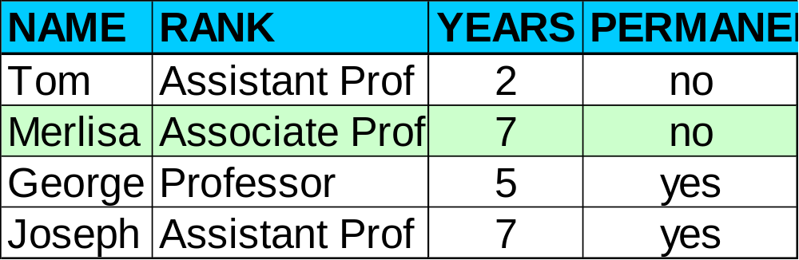

Process (2): Using the Model in Prediction
Classifier
Testing
Data
Unseen Data
(Jeff, Professor, 4)
PERMANENT?

Slide 11
Process (2): Using the Model in Prediction
Classifier
Testing
Data
Unseen Data
(Jeff, Professor, 4)
PERMANENT?

Slide 12
Chapter 8. Classification: Basic Concepts
Classification: Basic Concepts
Decision Tree Induction
Bayes Classification Methods
Rule-Based Classification
Model Evaluation and Selection
Techniques to Improve Classification Accuracy: Ensemble Methods
Summary

Slide 13

Decision Tree Induction: An Example
Training data set: Buys_computer
The data set follows an example of Quinlan’s ID3
Resulting tree:
age?
<=30
overcast
>40
31..40
student?
yes
credit rating?
no
yes
excellent
fair
no
yes
no
yes

Slide 14
Algorithm for Decision Tree Induction
Basic algorithm (a greedy algorithm)
  Tree is constructed in a top-down recursive divide-and-conquer manner
  At start, all the training examples are at the root
  Attributes are categorical (if continuous-valued, they are discretized in advance)
  Examples are partitioned recursively based on selected attributes
  Test attributes are selected on the basis of a heuristic or statistical measure (e.g., information gain)
Conditions for stopping partitioning
  All samples for a given node belong to the same class
  There are no remaining attributes for further partitioning – majority voting is employed for classifying the leaf
  There are no samples left

Slide 15


Brief Review of Entropy
m = 2

Slide 16



Attribute Selection Measure: Information Gain (ID3/C4.5)
Select the attribute with the highest information gain
Let p_{i} be the probability that an arbitrary tuple in D belongs to class C_{i}, estimated by |C_{i, D}|/|D|
Expected information (entropy) needed to classify a tuple in D:
Information needed (after using A to split D into v partitions) to classify D:
Information gained by branching on attribute A
Notes:
I : the expected information needed to classify a given sample
E (entropy) : expected information based on the partitioning into subsets by A

Slide 17

Decision Tree Induction: An Example
Class : buys_computer = “yes”
Class : buys_computer = “no”

Slide 18

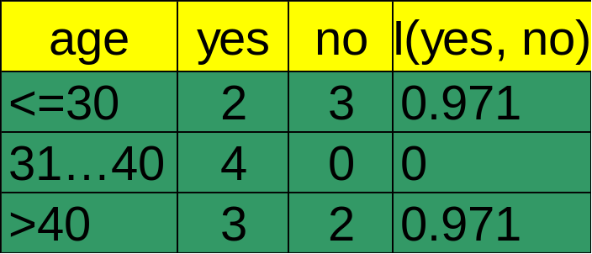



Attribute Selection: Information Gain
Class P: buys_computer = “yes”
Class N: buys_computer = “no”
means “age <=30” has 5 out of 14 samples, with 2 yes’es and 3 no’s. Hence
Similarly,

Slide 19
Computing Information-Gain for Continuous-Valued Attributes
Let attribute A be a continuous-valued attribute
Must determine the best split point for A
  Sort the value A in increasing order
  Typically, the midpoint between each pair of adjacent values is considered as a possible split point
    (a_{i}+a_{i+1})/2 is the midpoint between the values of a_{i} and a_{i+1}
  The point with the minimum expected information requirement for A is selected as the split-point for A
Split:
  D1 is the set of tuples in D satisfying A ≤ split-point, and D2 is the set of tuples in D satisfying A > split-point

Slide 20


Gain Ratio for Attribute Selection (C4.5)
Information gain measure is biased towards attributes with a large number of values
C4.5 (a successor of ID3) uses gain ratio to overcome the problem (normalization to information gain)
  GainRatio(A) = Gain(A)/SplitInfo(A)
Ex.
  gain_ratio(income) = 0.029/1.557 = 0.019
The attribute with the maximum gain ratio is selected as the splitting attribute
SELF STUDY

Slide 21




Gini Index (CART, IBM IntelligentMiner)
If a data set D contains examples from n classes, gini index, gini(D) is defined as
where p_{j} is the relative frequency of class j in D
If a data set D is split on A into two subsets D₁ and D₂, the gini index gini(D) is defined as
Reduction in Impurity:
The attribute provides the smallest gini_{split}(D) (or the largest reduction in impurity) is chosen to split the node (need to enumerate all the possible splitting points for each attribute)
SELF STUDY

Slide 22



Computation of Gini Index
Ex. D has 9 tuples in buys_computer = “yes” and 5 in “no”
Suppose the attribute income partitions D into 10 in D₁: {low, medium} and 4 in D₂
  Gini_{{low,high}} is 0.458; Gini_{{medium,high}} is 0.450. Thus, split on the {low,medium} (and {high}) since it has the lowest Gini index
All attributes are assumed continuous-valued
May need other tools, e.g., clustering, to get the possible split values
Can be modified for categorical attributes
SELF STUDY

Slide 23
Comparing Attribute Selection Measures
The three measures, in general, return good results but
  Information gain:
    biased towards multivalued attributes
  Gain ratio:
    tends to prefer unbalanced splits in which one partition is much smaller than the others
  Gini index:
    biased to multivalued attributes
    has difficulty when # of classes is large
    tends to favor tests that result in equal-sized partitions and purity in both partitions
SELF STUDY

Slide 24
Overfitting and Tree Pruning
Overfitting: An induced tree may overfit the training data
  Too many branches, some may reflect anomalies due to noise or outliers
  Poor accuracy for unseen samples
Two approaches to avoid overfitting
  Prepruning: Halt tree construction early ̵ do not split a node if this would result in the goodness measure falling below a threshold
    Difficult to choose an appropriate threshold
  Postpruning: Remove branches from a “fully grown” tree—get a sequence of progressively pruned trees
    Use a set of data different from the training data to decide which is the “best pruned tree”

Slide 25
Chapter 8. Classification: Basic Concepts
Classification: Basic Concepts
Decision Tree Induction
Bayes Classification Methods
Rule-Based Classification
Model Evaluation and Selection
Techniques to Improve Classification Accuracy: Ensemble Methods
Summary

Slide 26
Bayesian Classification: Why?
A statistical classifier: performs probabilistic prediction, i.e., predicts class membership probabilities
Foundation: Based on Bayes’ Theorem.
Performance: A simple Bayesian classifier, naïve Bayesian classifier, has comparable performance with decision tree and selected neural network classifiers
Incremental: Each training example can incrementally increase/decrease the probability that a hypothesis is correct — prior knowledge can be combined with observed data

Slide 27
A very simple dataset – one field / one class
P34 level | Prostate cancer
High | Y
Medium | Y
Low | Y
Low | N
Low | N
Medium | N
High | Y
High | N
Low | N
Medium | Y

Slide 28
A very simple dataset – one field / one class
P34 level | Prostate cancer
High | Y
Medium | Y
Low | Y
Low | N
Low | N
Medium | N
High | Y
High | N
Low | N
Medium | Y
A new patient has
a blood test – his P34
level is HIGH.
what is our best guess
for prostate cancer?

Slide 29
A very simple dataset – one field / one class
P34 level | Prostate cancer
High | Y
Medium | Y
Low | Y
Low | N
Low | N
Medium | N
High | Y
High | N
Low | N
Medium | Y
It’s useful to know:
P(cancer = Y)

Slide 30
A very simple dataset – one field / one class
P34 level | Prostate cancer
High | Y
Medium | Y
Low | Y
Low | N
Low | N
Medium | N
High | Y
High | N
Low | N
Medium | Y
It’s useful to know:
P(cancer = Y)
- on basis of this tiny
dataset, P(c = Y)
is 5/10 = 0.5

Slide 31
A very simple dataset – one field / one class
P34 level | Prostate cancer
High | Y
Medium | Y
Low | Y
Low | N
Low | N
Medium | N
High | Y
High | N
Low | N
Medium | Y
It’s useful to know:
P(cancer = Y)
- on basis of this tiny
dataset, P(c = Y)
is 5/10 = 0.5
So, with no other info you’d expect
P(cancer=Y) to be 0.5

Slide 32
A very simple dataset – one field / one class
P34 level | Prostate cancer
High | Y
Medium | Y
Low | Y
Low | N
Low | N
Medium | N
High | Y
High | N
Low | N
Medium | Y
But we know that P34 =H,
so actually we want:
P(cancer=Y | P34 = H)
- the prob that cancer is Y,
given that P34 is high

Slide 33
A very simple dataset – one field / one class
P(cancer=Y | P34 = H)
- the prob that cancer is Y,
given that P34 is high
- this seems to be
2/3 = ~ 0.67
P34 level | Prostate cancer
High | Y
Medium | Y
Low | Y
Low | N
Low | N
Medium | N
High | Y
High | N
Low | N
Medium | Y

Slide 34
A very simple dataset – one field / one class
So we have:
P ( c=Y | P34 = H) = 0.67
P ( c =N | P34 = H) = 0.33
The class value with the
highest probability is our
best guess
P34 level | Prostate cancer
High | Y
Medium | Y
Low | Y
Low | N
Low | N
Medium | N
High | Y
High | N
Low | N
Medium | Y

Slide 35
In general we may have any number of class values
suppose again we know that
P34 is High;
here we have:
P ( c=Y | P34 = H) = 0.5
P ( c=N | P34 = H) = 0.25
P(c = Maybe | H) = 0.25
... and again, Y is the winner
P34 level | Prostate cancer
High | Y
Medium | Y
Low | Y
Low | N
Low | N
Medium | N
High | Y
High | N
High | Maybe
Medium | Y

Slide 36
That is the essence of Naive Bayes, but: the probability calculations are much trickier when there are >1 fields so we make a ‘Naive’ assumption that makes it simpler

Slide 37
Bayes’ theorem
As we saw, on the right
we are illustrating:
P(cancer = Y | P34 = H)
P34 level | Prostate cancer
High | Y
Medium | Y
Low | Y
Low | N
Low | N
Medium | N
High | Y
High | N
Low | N
Medium | Y

Slide 38
Bayes’ theorem
And now we are illustrating
P(P34 = H | cancer = Y)
This is a different thing,
that turns out as 2/5 = 0.4
P34 level | Prostate cancer
High | Y
Medium | Y
Low | Y
Low | N
Low | N
Medium | N
High | Y
High | N
Low | N
Medium | Y

Slide 39
Bayes’ theorem is this:
P( A | B) = P ( B | A ) P (A)
P(B)
It is very useful when it is hard to get P(A | B) directly, but easier to get the things on the right

Slide 40

Bayes’ Theorem: Basics
Bayes’ Theorem:
  Let X be a data sample (“evidence”): class label is unknown
  Let H be a hypothesis that X belongs to class C
  Classification is to determine P(H|X), (i.e., posteriori probability): the probability that the hypothesis holds given the observed data sample X
  P(H) (prior probability): the initial probability
    E.g., X will buy computer, regardless of age, income, …
  P(X): probability that sample data is observed
  P(X|H) (likelihood): the probability of observing the sample X, given that the hypothesis holds
    E.g., Given that X will buy computer, the prob. that X is 31..40, medium income

Slide 41
Prediction Based on Bayes’ Theorem
Given training data X, posteriori probability of a hypothesis H, P(H|X), follows the Bayes’ theorem
Informally, this can be viewed as
  posteriori = likelihood x prior/evidence
Predicts X belongs to C_{i} iff the probability P(C_{i}|X) is the highest among all the P(C_{k}|X) for all the k classes
Practical difficulty: It requires initial knowledge of many probabilities, involving significant computational cost

Slide 42


Classification Is to Derive the Maximum Posteriori
Let D be a training set of tuples and their associated class labels, and each tuple is represented by an n-D attribute vector X = (x₁, x₂, …, x_{n})
Suppose there are m classes C₁, C₂, …, C_{m}.
Classification is to derive the maximum posteriori, i.e., the maximal P(C_{i}|X)
This can be derived from Bayes’ theorem
Since P(X) is constant for all classes, only
  needs to be maximized

Slide 43

Naïve Bayes Classifier
A simplified assumption: attributes are conditionally independent (i.e., no dependence relation between attributes):
This greatly reduces the computation cost: Only counts the class distribution
If A_{k} is categorical, P(x_{k}|C_{i}) is the # of tuples in C_{i} having value x_{k} for A_{k} divided by |C_{i, D}| (# of tuples of C_{i} in D)

Slide 44

Naïve Bayes Classifier: Training Dataset
Class:
C1:buys_computer = ‘yes’
C2:buys_computer = ‘no’
Data to be classified:
X = (age <=30,
Income = medium,
Student = yes
Credit_rating = Fair)

Slide 45
Naïve Bayes Classifier: An Example
P(C_{i}): P(buys_computer = “yes”) = 9/14 = 0.643
P(buys_computer = “no”) = 5/14= 0.357
Compute P(X|C_{i}) for each class
  P(age = “<=30” | buys_computer = “yes”) = 2/9 = 0.222
  P(age = “<= 30” | buys_computer = “no”) = 3/5 = 0.6
  P(income = “medium” | buys_computer = “yes”) = 4/9 = 0.444
  P(income = “medium” | buys_computer = “no”) = 2/5 = 0.4
  P(student = “yes” | buys_computer = “yes) = 6/9 = 0.667
  P(student = “yes” | buys_computer = “no”) = 1/5 = 0.2
  P(credit_rating = “fair” | buys_computer = “yes”) = 6/9 = 0.667
  P(credit_rating = “fair” | buys_computer = “no”) = 2/5 = 0.4
X = (age <= 30 , income = medium, student = yes, credit_rating = fair)
P(X|C_{i}) : P(X|buys_computer = “yes”) = 0.222 x 0.444 x 0.667 x 0.667 = 0.044
P(X|buys_computer = “no”) = 0.6 x 0.4 x 0.2 x 0.4 = 0.019
P(X|C_{i})*P(C_{i}) : P(X|buys_computer = “yes”) * P(buys_computer = “yes”) = 0.028
P(X|buys_computer = “no”) * P(buys_computer = “no”) = 0.007
Therefore, X belongs to class (“buys_computer = yes”)
Data to be classified:
X = (age <=30,
Income = medium,
Student = yes
Credit_rating = Fair)

Slide 46

Avoiding the Zero-Probability Problem
Naïve Bayesian prediction requires each conditional prob. be non-zero. Otherwise, the predicted prob. will be zero
Ex. Suppose a dataset with 1000 tuples, income=low (0), income= medium (990), and income = high (10)
Use Laplacian correction (or Laplacian estimator)
  Adding 1 to each case
    Prob(income = low) = 1/1003
    Prob(income = medium) = 991/1003
    Prob(income = high) = 11/1003
  The “corrected” prob. estimates are close to their “uncorrected” counterparts

Slide 47
Naïve Bayes Classifier: Comments
Advantages
  Easy to implement
  Good results obtained in most of the cases
Disadvantages
  Assumption: class conditional independence, therefore loss of accuracy
  Practically, dependencies exist among variables
    E.g., hospitals: patients: Profile: age, family history, etc.
      Symptoms: fever, cough etc., Disease: lung cancer, diabetes, etc.
    Dependencies among these cannot be modeled by Naïve Bayes Classifier
How to deal with these dependencies? Bayesian Belief Networks (Chapter 9)

Slide 48
Chapter 8. Classification: Basic Concepts
Classification: Basic Concepts
Decision Tree Induction
Bayes Classification Methods
Rule-Based Classification
Model Evaluation and Selection
Techniques to Improve Classification Accuracy: Ensemble Methods
Summary

Slide 49
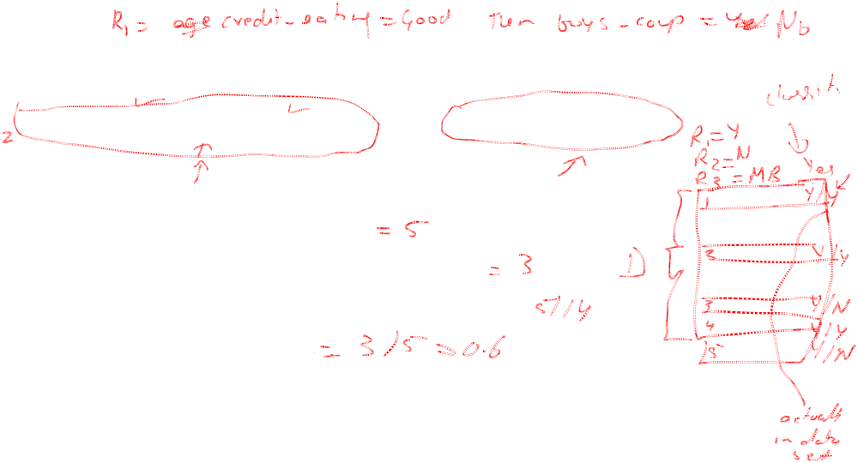
Using IF-THEN Rules for Classification
Represent the knowledge in the form of IF-THEN rules
  R: IF age = youth AND student = yes THEN buys_computer = yes
  Rule antecedent/precondition vs. rule consequent
Assessment of a rule: coverage and accuracy
  n_{covers} = # of tuples covered by R
  n_{correct} = # of tuples correctly classified by R
  coverage(R) = n_{covers} /|D| /* D: training data set */
  accuracy(R) = n_{correct} / n_{covers}
If more than one rule are triggered, need conflict resolution
  Size ordering: assign the highest priority to the triggering rules that has the “toughest” requirement (i.e., with the most attribute tests)
  Class-based ordering: decreasing order of prevalence or misclassification cost per class
  Rule-based ordering (decision list): rules are organized into one long priority list, according to some measure of rule quality or by experts

Slide 50
Rule Extraction from a Decision Tree
Rules are easier to understand than large trees
One rule is created for each path from the root to a leaf
Each attribute-value pair along a path forms a conjunction: the leaf holds the class prediction
Rules are mutually exclusive and exhaustive
age?
<=30
31..40
>40
student?
yes
credit rating?
no
yes
excellent
fair
no
yes
no
yes
Example: Rule extraction from our buys_computer decision-tree
  IF age = young AND student = no THEN buys_computer = no
  IF age = young AND student = yes THEN buys_computer = yes
  IF age = mid-age THEN buys_computer = yes
  IF age = old AND credit_rating = excellent THEN buys_computer = no
  IF age = old AND credit_rating = fair THEN buys_computer = yes

Slide 51
Rule Induction: Sequential Covering Method
Sequential covering algorithm: Extracts rules directly from training data
Typical sequential covering algorithms: FOIL, AQ, CN2, RIPPER
Rules are learned sequentially, each for a given class C_{i} will cover many tuples of C_{i} but none (or few) of the tuples of other classes
Steps:
  Rules are learned one at a time
  Each time a rule is learned, the tuples covered by the rules are removed
  Repeat the process on the remaining tuples until termination condition, e.g., when no more training examples or when the quality of a rule returned is below a user-specified threshold
Comp. w. decision-tree induction: learning a set of rules simultaneously

Slide 52
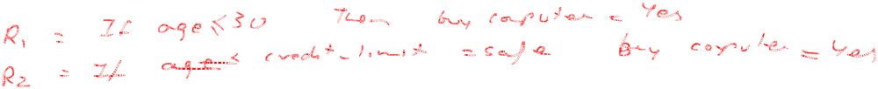
Sequential Covering Algorithm
while (enough target tuples left)
  generate a rule
  remove positive target tuples satisfying this rule
Examples covered
by Rule 2
Examples covered
by Rule 1
Examples covered
by Rule 3
Positive examples

Slide 53
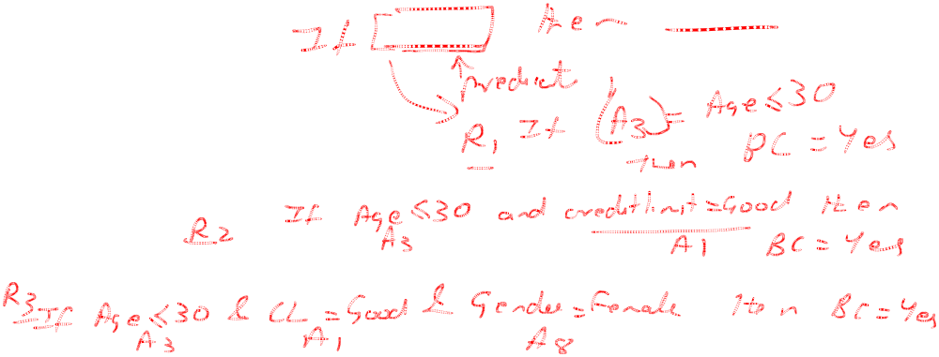
Rule Generation
To generate a rule
  while(true)
  find the best predicate p
  if foil-gain(p) > threshold then add p to current rule
  else break
A3=1
A3=1&&A1=2
A3=1&&A1=2
&&A8=5
Positive examples
Negative examples

Slide 54
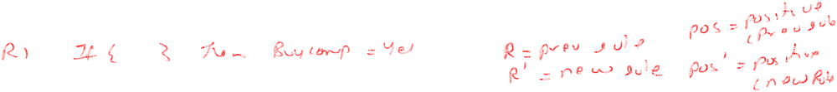


How to Learn-One-Rule?
Start with the most general rule possible: condition = empty
Adding new attributes by adopting a greedy depth-first strategy
  Picks the one that most improves the rule quality
Rule-Quality measures: consider both coverage and accuracy
  Foil-gain (in FOIL & RIPPER): assesses info_gain by extending condition
    favors rules that have high accuracy and cover many positive tuples
Rule pruning based on an independent set of test tuples
    Pos/neg are # of positive/negative tuples covered by R.
    If FOIL_Prune is higher for the pruned version of R, prune R

Slide 55
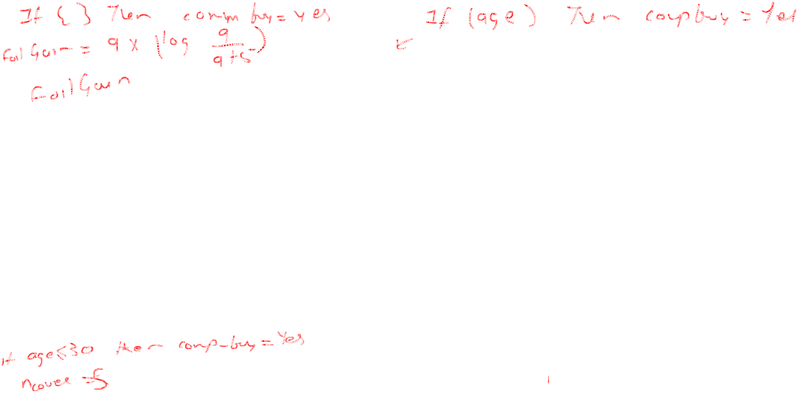
age?
<=30
31..40
>40
student?
yes
credit rating?
no
yes
excellent
fair
no
yes
no
yes

Slide 56
Chapter 8. Classification: Basic Concepts
Classification: Basic Concepts
Decision Tree Induction
Bayes Classification Methods
Rule-Based Classification
Model Evaluation and Selection
Techniques to Improve Classification Accuracy: Ensemble Methods
Summary

Slide 57
Model Evaluation and Selection
Evaluation metrics: How can we measure accuracy? Other metrics to consider?
Use validation test set of class-labeled tuples instead of training set when assessing accuracy
Methods for estimating a classifier’s accuracy:
  Holdout method, random subsampling
  Cross-validation
  Bootstrap
Comparing classifiers:
  Confidence intervals
  Cost-benefit analysis and ROC Curves

Slide 58
Classifier Evaluation Metrics: Confusion Matrix
Confusion Matrix:
Actual class\Predicted class | C₁ | ¬ C₁
C₁ | True Positives (TP) | False Negatives (FN)
¬ C₁ | False Positives (FP) | True Negatives (TN)
Example of Confusion Matrix:
Actual class\Predicted class | buy_computer = yes | buy_computer = no | Total
buy_computer = yes | 6954 | 46 | 7000
buy_computer = no | 412 | 2588 | 3000
Total | 7366 | 2634 | 10000
Given m classes, an entry, CM_{i,j} in a confusion matrix indicates # of tuples in class i that were labeled by the classifier as class j
May have extra rows/columns to provide totals

Slide 59
Classifier Evaluation Metrics: Accuracy, Error Rate, Sensitivity and Specificity
A\P | C | ¬C
C | TP | FN | P
¬C | FP | TN | N
 | P’ | N’ | All
Class Imbalance Problem:
  One class may be rare, e.g. fraud, or HIV-positive
  Significant majority of the negative class and minority of the positive class
  Sensitivity: True Positive recognition rate
    Sensitivity = TP/P
  Specificity: True Negative recognition rate
    Specificity = TN/N
Classifier Accuracy, or recognition rate: percentage of test set tuples that are correctly classified
  Accuracy = (TP + TN)/All
Error rate: 1 – accuracy, or
  Error rate = (FP + FN)/All

Slide 60




Classifier Evaluation Metrics:
Precision and Recall, and F-measures
Precision: exactness – what % of tuples that the classifier labeled as positive are actually positive
Recall: completeness – what % of positive tuples did the classifier label as positive?
Perfect score is 1.0
Inverse relationship between precision & recall
F measure (F₁ or F-score): harmonic mean of precision and recall,
F_{ß}: weighted measure of precision and recall
  assigns ß times as much weight to recall as to precision

Slide 61
Classifier Evaluation Metrics: Example
Actual Class\Predicted class | cancer = yes | cancer = no | Total | Recognition(%)
cancer = yes | 90 | 210 | 300 | 30.00 (sensitivity
cancer = no | 140 | 9560 | 9700 | 98.56 (specificity)
Total | 230 | 9770 | 10000 | 96.40 (accuracy)
  Precision = 90/230 = 39.13% Recall = 90/300 = 30.00%

Slide 62
Evaluating Classifier Accuracy:
Holdout & Cross-Validation Methods
Holdout method
  Given data is randomly partitioned into two independent sets
    Training set (e.g., 2/3) for model construction
    Test set (e.g., 1/3) for accuracy estimation
  Random sampling: a variation of holdout
    Repeat holdout k times, accuracy = avg. of the accuracies obtained
Cross-validation (k-fold, where k = 10 is most popular)
  Randomly partition the data into k mutually exclusive subsets, each approximately equal size
  At i-th iteration, use D_{i} as test set and others as training set
  Leave-one-out: k folds where k = # of tuples, for small sized data
  *Stratified cross-validation*: folds are stratified so that class dist. in each fold is approx. the same as that in the initial data

Slide 63

Evaluating Classifier Accuracy: Bootstrap
Bootstrap
  Works well with small data sets
  Samples the given training tuples uniformly with replacement
    i.e., each time a tuple is selected, it is equally likely to be selected again and re-added to the training set
Several bootstrap methods, and a common one is .632 boostrap
  A data set with d tuples is sampled d times, with replacement, resulting in a training set of d samples. The data tuples that did not make it into the training set end up forming the test set. About 63.2% of the original data end up in the bootstrap, and the remaining 36.8% form the test set (since (1 – 1/d)^{d} ≈ e⁻¹ = 0.368)
  Repeat the sampling procedure k times, overall accuracy of the model:

Slide 64


Estimating Confidence Intervals:
Classifier Models M₁ vs. M₂
Suppose we have 2 classifiers, M₁ and M₂, which one is better?
Use 10-fold cross-validation to obtain and
These mean error rates are just estimates of error on the true population of future data cases
What if the difference between the 2 error rates is just attributed to chance?
  Use a test of statistical significance
  Obtain confidence limits for our error estimates

Slide 65
Estimating Confidence Intervals:
Null Hypothesis
Perform 10-fold cross-validation
Assume samples follow a t distribution with k–1 degrees of freedom (here, k=10)
Use t-test (or Student’s t-test)
Null Hypothesis: M₁ & M₂ are the same
If we can reject null hypothesis, then
  we conclude that the difference between M₁ & M₂ is statistically significant
  Chose model with lower error rate

Slide 66


Estimating Confidence Intervals: t-test
If only 1 test set available: pairwise comparison
  For i^{th} round of 10-fold cross-validation, the same cross partitioning is used to obtain err(M₁)_{i} and err(M₂)_{i}
  Average over 10 rounds to get
  t-test computes t-statistic with k-1 degrees of freedom:
If two test sets available: use non-paired t-test
and
where
where
where k₁ & k₂ are # of cross-validation samples used for M₁ & M₂, resp.

Slide 67


Estimating Confidence Intervals:
Table for t-distribution
Symmetric
Significance level, e.g., sig = 0.05 or 5% means M₁ & M₂ are significantly different for 95% of population
Confidence limit, z = sig/2

Slide 68
Estimating Confidence Intervals:
Statistical Significance
Are M₁ & M₂ significantly different?
  Compute t. Select significance level (e.g. sig = 5%)
  Consult table for t-distribution: Find t value corresponding to k-1 degrees of freedom (here, 9)
  t-distribution is symmetric: typically upper % points of distribution shown → look up value for confidence limit z=sig/2 (here, 0.025)
  If t > z or t < -z, then t value lies in rejection region:
    Reject null hypothesis that mean error rates of M₁ & M₂ are same
    Conclude: statistically significant difference between M₁ & M₂
  Otherwise, conclude that any difference is chance

Slide 69

Model Selection: ROC Curves
ROC (Receiver Operating Characteristics) curves: for visual comparison of classification models
Originated from signal detection theory
Shows the trade-off between the true positive rate and the false positive rate
The area under the ROC curve is a measure of the accuracy of the model
Rank the test tuples in decreasing order: the one that is most likely to belong to the positive class appears at the top of the list
The closer to the diagonal line (i.e., the closer the area is to 0.5), the less accurate is the model
Vertical axis represents the true positive rate
Horizontal axis rep. the false positive rate
The plot also shows a diagonal line
A model with perfect accuracy will have an area of 1.0

Slide 70
Issues Affecting Model Selection
Accuracy
  classifier accuracy: predicting class label
Speed
  time to construct the model (training time)
  time to use the model (classification/prediction time)
Robustness: handling noise and missing values
Scalability: efficiency in disk-resident databases
Interpretability
  understanding and insight provided by the model
Other measures, e.g., goodness of rules, such as decision tree size or compactness of classification rules

Slide 71
Chapter 8. Classification: Basic Concepts
Classification: Basic Concepts
Decision Tree Induction
Bayes Classification Methods
Rule-Based Classification
Model Evaluation and Selection
Techniques to Improve Classification Accuracy: Ensemble Methods
Summary

Slide 72

Ensemble Methods: Increasing the Accuracy
Ensemble methods
  Use a combination of models to increase accuracy
  Combine a series of k learned models, M₁, M₂, …, M_{k}, with the aim of creating an improved model M*
Popular ensemble methods
  Bagging: averaging the prediction over a collection of classifiers
  Boosting: weighted vote with a collection of classifiers
  Ensemble: combining a set of heterogeneous classifiers

Slide 73
Bagging: Boostrap Aggregation
Analogy: Diagnosis based on multiple doctors’ majority vote
Training
  Given a set D of d tuples, at each iteration i, a training set D_{i} of d tuples is sampled with replacement from D (i.e., bootstrap)
  A classifier model M_{i} is learned for each training set D_{i}
Classification: classify an unknown sample X
  Each classifier M_{i} returns its class prediction
  The bagged classifier M* counts the votes and assigns the class with the most votes to X
Prediction: can be applied to the prediction of continuous values by taking the average value of each prediction for a given test tuple
Accuracy
  Often significantly better than a single classifier derived from D
  For noise data: not considerably worse, more robust
  Proved improved accuracy in prediction

Slide 74
Boosting
Analogy: Consult several doctors, based on a combination of weighted diagnoses—weight assigned based on the previous diagnosis accuracy
How boosting works?
  Weights are assigned to each training tuple
  A series of k classifiers is iteratively learned
  After a classifier M_{i} is learned, the weights are updated to allow the subsequent classifier, M_{i+1}, to pay more attention to the training tuples that were misclassified by M_{i}
  The final M* combines the votes of each individual classifier, where the weight of each classifier's vote is a function of its accuracy
Boosting algorithm can be extended for numeric prediction
Comparing with bagging: Boosting tends to have greater accuracy, but it also risks overfitting the model to misclassified data

Slide 75


Adaboost (Freund and Schapire, 1997)
Given a set of d class-labeled tuples, (X₁, y₁), …, (X_{d}, y_{d})
Initially, all the weights of tuples are set the same (1/d)
Generate k classifiers in k rounds. At round i,
  Tuples from D are sampled (with replacement) to form a training set D_{i} of the same size
  Each tuple’s chance of being selected is based on its weight
  A classification model M_{i} is derived from D_{i}
  Its error rate is calculated using D_{i} as a test set
  If a tuple is misclassified, its weight is increased, o.w. it is decreased
Error rate: err(X_{j}) is the misclassification error of tuple X_{j}. Classifier M_{i} error rate is the sum of the weights of the misclassified tuples:
The weight of classifier M_{i}’s vote is

Slide 76
Random Forest (Breiman 2001)
Random Forest:
  Each classifier in the ensemble is a decision tree classifier and is generated using a random selection of attributes at each node to determine the split
  During classification, each tree votes and the most popular class is returned
Two Methods to construct Random Forest:
  Forest-RI (random input selection): Randomly select, at each node, F attributes as candidates for the split at the node. The CART methodology is used to grow the trees to maximum size
  Forest-RC (random linear combinations): Creates new attributes (or features) that are a linear combination of the existing attributes (reduces the correlation between individual classifiers)
Comparable in accuracy to Adaboost, but more robust to errors and outliers
Insensitive to the number of attributes selected for consideration at each split, and faster than bagging or boosting

Slide 77
Classification of Class-Imbalanced Data Sets
Class-imbalance problem: Rare positive example but numerous negative ones, e.g., medical diagnosis, fraud, oil-spill, fault, etc.
Traditional methods assume a balanced distribution of classes and equal error costs: not suitable for class-imbalanced data
Typical methods for imbalance data in 2-class classification:
  Oversampling: re-sampling of data from positive class
  Under-sampling: randomly eliminate tuples from negative class
  Threshold-moving: moves the decision threshold, t, so that the rare class tuples are easier to classify, and hence, less chance of costly false negative errors
  Ensemble techniques: Ensemble multiple classifiers introduced above
Still difficult for class imbalance problem on multiclass tasks

Slide 78
Chapter 8. Classification: Basic Concepts
Classification: Basic Concepts
Decision Tree Induction
Bayes Classification Methods
Rule-Based Classification
Model Evaluation and Selection
Techniques to Improve Classification Accuracy: Ensemble Methods
Summary

Slide 79
Summary (I)
Classification is a form of data analysis that extracts models describing important data classes.
Effective and scalable methods have been developed for decision tree induction, Naive Bayesian classification, rule-based classification, and many other classification methods.
Evaluation metrics include: accuracy, sensitivity, specificity, precision, recall, F measure, and F_{ß} measure.
Stratified k-fold cross-validation is recommended for accuracy estimation. Bagging and boosting can be used to increase overall accuracy by learning and combining a series of individual models.

Slide 80
Summary (II)
Significance tests and ROC curves are useful for model selection.
There have been numerous comparisons of the different classification methods; the matter remains a research topic
No single method has been found to be superior over all others for all data sets
Issues such as accuracy, training time, robustness, scalability, and interpretability must be considered and can involve trade-offs, further complicating the quest for an overall superior method

Slide 81
References (1)
C. Apte and S. Weiss. Data mining with decision trees and decision rules. Future Generation Computer Systems, 13, 1997
C. M. Bishop, Neural Networks for Pattern Recognition. Oxford University Press, 1995
L. Breiman, J. Friedman, R. Olshen, and C. Stone. Classification and Regression Trees. Wadsworth International Group, 1984
C. J. C. Burges. A Tutorial on Support Vector Machines for Pattern Recognition. Data Mining and Knowledge Discovery, 2(2): 121-168, 1998
P. K. Chan and S. J. Stolfo. Learning arbiter and combiner trees from partitioned data for scaling machine learning. KDD'95
H. Cheng, X. Yan, J. Han, and C.-W. Hsu, Discriminative Frequent Pattern Analysis for Effective Classification, ICDE'07
H. Cheng, X. Yan, J. Han, and P. S. Yu, Direct Discriminative Pattern Mining for Effective Classification, ICDE'08
W. Cohen. Fast effective rule induction. ICML'95
G. Cong, K.-L. Tan, A. K. H. Tung, and X. Xu. Mining top-k covering rule groups for gene expression data. SIGMOD'05

Slide 82
References (2)
A. J. Dobson. An Introduction to Generalized Linear Models. Chapman & Hall, 1990.
G. Dong and J. Li. Efficient mining of emerging patterns: Discovering trends and differences. KDD'99.
R. O. Duda, P. E. Hart, and D. G. Stork. Pattern Classification, 2ed. John Wiley, 2001
U. M. Fayyad. Branching on attribute values in decision tree generation. AAAI’94.
Y. Freund and R. E. Schapire. A decision-theoretic generalization of on-line learning and an application to boosting. J. Computer and System Sciences, 1997.
J. Gehrke, R. Ramakrishnan, and V. Ganti. Rainforest: A framework for fast decision tree construction of large datasets. VLDB’98.
J. Gehrke, V. Gant, R. Ramakrishnan, and W.-Y. Loh, BOAT -- Optimistic Decision Tree Construction. SIGMOD'99.
T. Hastie, R. Tibshirani, and J. Friedman. The Elements of Statistical Learning: Data Mining, Inference, and Prediction. Springer-Verlag, 2001.
D. Heckerman, D. Geiger, and D. M. Chickering. Learning Bayesian networks: The combination of knowledge and statistical data. Machine Learning, 1995.
W. Li, J. Han, and J. Pei, CMAR: Accurate and Efficient Classification Based on Multiple Class-Association Rules, ICDM'01.

Slide 83
References (3)
T.-S. Lim, W.-Y. Loh, and Y.-S. Shih. A comparison of prediction accuracy, complexity, and training time of thirty-three old and new classification algorithms. Machine Learning, 2000.
J. Magidson. The Chaid approach to segmentation modeling: Chi-squared automatic interaction detection. In R. P. Bagozzi, editor, Advanced Methods of Marketing Research, Blackwell Business, 1994.
M. Mehta, R. Agrawal, and J. Rissanen. SLIQ : A fast scalable classifier for data mining. EDBT'96.
T. M. Mitchell. Machine Learning. McGraw Hill, 1997.
S. K. Murthy, Automatic Construction of Decision Trees from Data: A Multi-Disciplinary Survey, Data Mining and Knowledge Discovery 2(4): 345-389, 1998
J. R. Quinlan. Induction of decision trees. Machine Learning, 1:81-106, 1986.
J. R. Quinlan and R. M. Cameron-Jones. FOIL: A midterm report. ECML’93.
J. R. Quinlan. C4.5: Programs for Machine Learning. Morgan Kaufmann, 1993.
J. R. Quinlan. Bagging, boosting, and c4.5. AAAI'96.

Slide 84
References (4)
R. Rastogi and K. Shim. Public: A decision tree classifier that integrates building and pruning. VLDB’98.
J. Shafer, R. Agrawal, and M. Mehta. SPRINT : A scalable parallel classifier for data mining. VLDB’96.
J. W. Shavlik and T. G. Dietterich. Readings in Machine Learning. Morgan Kaufmann, 1990.
P. Tan, M. Steinbach, and V. Kumar. Introduction to Data Mining. Addison Wesley, 2005.
S. M. Weiss and C. A. Kulikowski. Computer Systems that Learn: Classification and Prediction Methods from Statistics, Neural Nets, Machine Learning, and Expert Systems. Morgan Kaufman, 1991.
S. M. Weiss and N. Indurkhya. Predictive Data Mining. Morgan Kaufmann, 1997.
I. H. Witten and E. Frank. Data Mining: Practical Machine Learning Tools and Techniques, 2ed. Morgan Kaufmann, 2005.
X. Yin and J. Han. CPAR: Classification based on predictive association rules. SDM'03
H. Yu, J. Yang, and J. Han. Classifying large data sets using SVM with hierarchical clusters. KDD'03.

Slide 85


Slide 86
CS412 Midterm Exam Statistics
Opinion Question Answering:
  Like the style: 70.83%, dislike: 29.16%
  Exam is hard: 55.75%, easy: 0.6%, just right: 43.63%
  Time: plenty:3.03%, enough: 36.96%, not: 60%
  Score distribution: # of students (Total: 180)
  >=90: 24
  80-89: 54
  70-79: 46
Final grading are based on overall score accumulation and relative class distributions
  60-69: 37
  50-59: 15
  40-49: 2
  <40: 2

Slide 87
Issues: Evaluating Classification Methods
Accuracy
  classifier accuracy: predicting class label
  predictor accuracy: guessing value of predicted attributes
Speed
  time to construct the model (training time)
  time to use the model (classification/prediction time)
Robustness: handling noise and missing values
Scalability: efficiency in disk-resident databases
Interpretability
  understanding and insight provided by the model
Other measures, e.g., goodness of rules, such as decision tree size or compactness of classification rules

Slide 88




Predictor Error Measures
Measure predictor accuracy: measure how far off the predicted value is from the actual known value
Loss function: measures the error betw. y_{i} and the predicted value y_{i}’
  Absolute error: | y_{i} – y_{i}’|
  Squared error: (y_{i} – y_{i}’)²
Test error (generalization error): the average loss over the test set
  Mean absolute error: Mean squared error:
  Relative absolute error: Relative squared error:
  The mean squared-error exaggerates the presence of outliers
  Popularly use (square) root mean-square error, similarly, root relative squared error

Slide 89
Scalable Decision Tree Induction Methods
SLIQ (EDBT’96 — Mehta et al.)
  Builds an index for each attribute and only class list and the current attribute list reside in memory
SPRINT (VLDB’96 — J. Shafer et al.)
  Constructs an attribute list data structure
PUBLIC (VLDB’98 — Rastogi & Shim)
  Integrates tree splitting and tree pruning: stop growing the tree earlier
RainForest (VLDB’98 — Gehrke, Ramakrishnan & Ganti)
  Builds an AVC-list (attribute, value, class label)
BOAT (PODS’99 — Gehrke, Ganti, Ramakrishnan & Loh)
  Uses bootstrapping to create several small samples

Slide 90
Data Cube-Based Decision-Tree Induction
Integration of generalization with decision-tree induction (Kamber et al.’97)
Classification at primitive concept levels
  E.g., precise temperature, humidity, outlook, etc.
  Low-level concepts, scattered classes, bushy classification-trees
  Semantic interpretation problems
Cube-based multi-level classification
  Relevance analysis at multi-levels
  Information-gain analysis with dimension + level

